Slide 1
The New Ukraine SIG
TWO Years Later
Dr. Ronald D. Doctor, Coordinator
JewishGen Ukraine Special Interest Group (SIG)
rddpdx@gmail.com
www.jewishgen.org/ukraine

Slide 2
MISSION
The first 3 years: 2010-2013
Revitalize and Organize
Ukraine SIG:
The goal is to continue growth as a useful resource for Jewish family history researchers
7 August 2013

Slide 3
Objective
Acquire, translate and make freely available, documents, data and other resources to assist researchers whose Jewish ancestors lived in Ukraine
7 August 2013

Slide 4
Ukraine SIG
Geographical Coverage
(Provinces of the former Russian Empire)
Chernigov
Kharkov
Kherson
Kyiv
Podolia
Poltava
Taurida
Volhynia
Yekaterinoslav
Some parts of modern Ukraine are not included
7 August 2013

Slide 5
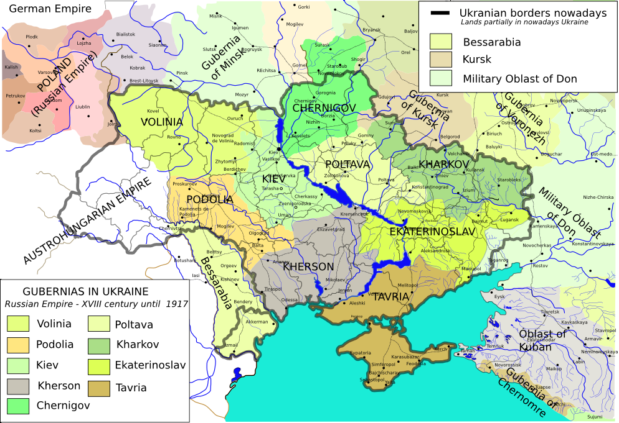
7 August 2013

Slide 6
Areas in modern Ukraine
NOT under Ukraine SIG
Bessarabia (new Bessarabia SIG)
Sub-Carpathia (Hungary SIG)
Western Ukraine lands that were in Galicia during Interwar period (Gesher Galicia)
Most of Bukovina (Romania SIG)
(For an explanation of these assignments, see http://www.jewishgen.org/projects/desc/ShtetlMasterRegions.html )
7 August 2013

Slide 7
What We’ll Discuss Today
The Past Year: Growth of the SIG, New and On-Going Projects
The SIG Website http://www.jewishgen.org/ukraine
Looking Ahead
The Ukraine SIG Languages & Skills Survey
(http://www.jewishgen.org/ukraine/ABT_Survey.asp)
7 August 2013

Slide 8
Ukraine SIG
Components of the SIG
E-Mail (Coordinator, Board, Project Managers)
Website
http://www.jewishgen.org/Ukraine
Discussion List - growth to 3,168 subscribers – last year at this time 2,876
Facebook (362 “likes”)
JewishGen Ukraine Database
http://www.jewishgen.org/databases/Ukraine/
7 August 2013

Slide 9
Ukraine SIG
Related JewishGen Resources
Over 259 Yizkor Books for more than 183 towns
Yizkor Book Master Name Index (YBMNI) *
80 towns in Necrology database *
About 33 Cemeteries in JOWBR with 7,304 graves*
Holocaust database *
FTJP/JGFF *
* = included in JewishGen Ukraine DB
7 August 2013

Slide 10
What have we done in the past year?
Structural Changes - 1
After Re-structuring the Website
  Continued our shift to a Town & District focus
  Continued to create a Town Page for every town in our database
  Links to datasets and document collections on KehilaLinks websites and elsewhere
Town Leaders …
  Increased to 175
KehilaLinks Development …
  Increased to over 240 KehilaLinks
  40 SIG-Sponsored KehilaLinks
7 August 2013

Slide 11
What have we done in the past year?
Structural Changes - 2
Culture of Mutual Assistance … Improved Communications
  SIG Discussion Group … over 3,100 participants
  Facebook site … is still a work-in-progress
  Ensure timely responses to messages and requests for help
  3 PowerPoint Tutorials
  75 InfoSheets & “How-to” documents
  (http://www.jewishgen.org/ukraine/RES_Infosheets.asp)
Online Survey of Languages & Skills
(http://www.jewishgen.org/ukraine/ABT_Survey_Lang_Form.asp)
  Over 300 volunteers
  Over 70 translators currently working
7 August 2013

Slide 12
What have we done in the past year?
Projects - 1
Books with name lists: 3 projects in-progress, 1,000s of names
Prenumeranten: more than 200 books … 10,000s of names.
Name Lists: Trostyanets 1919 Pogrom List & Vishnevets 1748 Residents List ready for posting. 5 others in-progress
Russian language websites: Creating catalog, extracting records with millions of names and short biographical name lists.
Archives Catalog Cards: 1,331 cards for 25 towns, so far from CAHJP, plus 204 for Chechelnik from Vinnitsa State Archive.
Cemeteries: Trostyanets, Yampol, Zhitomir; 5,000 stones.
Censuses: 1795 Ostrog… 3,000 entries; 1811 Uman… 1,000 entries.
7 August 2013

Slide 13
What have we done in the past year?
Projects - 2
EIDB Reindexing: 30 towns are in progress.
KehilaLinks Data Extraction: Ananyev, Berdyansk, Poninka, 2 Agricultural Colonies almost done.
KehilaLinks Development: 10 SIG-sponsored sites created; Assisting owners with 5 other websites.
Vital Records: Chernigov, Monastyrishche, Odessa … 14,000 names ready for posting; Translation in-progress for Mokraya Kaligorka, Shpola, Ol’shana (3,200 names)
Yad Vashem Extracts: Kamennyy Brod in-progress

Slide 14
What have we done in the past year?
Projects - 5
Ellis Island Re-Indexing Project continued 25 towns are in progress including Fastov, Shumsk, Rafalovka, Snitkov, Vishnevets, Kalinovka, Litin and Pereyaslav
Scanned 36 FHL Microfilm reels (all records for 15 towns or districts and parts of 17 others) including Priluki, Shpola, Uman, Chernigov and Chigrin
Obtained 1,081 catalog cards for 24 towns from CAHJP & translated over 400 catalog cards
Developed methodology for sorting the Master Name Index (MNI)
Many more projects are ready to go … waiting for project managers and volunteers: we currently have 406 projects in progress
7 August 2013

Slide 15
Looking Ahead
Vital Records, Revision Lists, Holocaust Records
LDS Family History Library Microfilms
  Vital Records for 111 towns – 235 reels of microfilm – 35 scanned to date – continue to acquire and scan
  Revision Lists (19th Century Censuses) for 158 towns
CAHJP - continue to acquire and translate vital records, kahal docs, official documents …
Acquire & translate Holocaust era documents
  USHMM has 293 documents
  Yad Vashem has more than 1,000 documents
  Yahad in Unum has transcripts of interviews
7 August 2013

Slide 16
Russian Language Websites:
An Explanation of the CGR
The CGR Dataset is online at rosgenea.ru. It is in Russian and contains almost 4.2 million records.
Ariel Parkansky, Ukraine SIG’s Web Manager, downloaded 4,185,088 records many of which are about people caught up in the purges of the Stalinist era. Each record is for one person. Only a small percentage is for Jews and an even smaller percentage is for Jews in Ukraine.
Our task is to identify and extract records for Jews in Ukraine, translate and add them to the JewishGen Ukraine Database and the Ukraine SIG Master Name Index.
7 August 2013

Slide 17
Russian Language Websites
Center for Genealogical Research http://www.rosgenea.ru
Biographical Name Lists
Кац Арон Наумович (1899,Смоленск---1936) еврей, арестован в 1936 г., осудивший орган: Тройка УНКВД по ДС, осужден 1937.09.10, статья: контрреволюционная троцкистская деятельность, расстрелян 1937.10.01, реабилитирован 1989.03.18 [Магадан]
Google Translation
Aaron Katz Naumovich (1899, Smolensk --- 1936), a Jew, was arrested in 1936, which condemned the organ: NKVD Troika of DC, convicted 1937.09.10, Article: Trotskyist counter-revolutionary activities, was shot 1937.10.01, 1989.03.18 rehabilitated [Magadan ]
7 August 2013

Slide 18
Preparing the CGR Data
To prepare the dataset for processing, we created separate fields for Given Name & Patronymic and extracted those names from the Surname/Given Name/Patronymic field. In addition, we added geographic area fields: town name, district, and province.
We applied our selection criteria to one of the 55 segments of data that Ariel downloaded from the online CGR database. Of the 64,993 non-duplicated records in this subset, we found:
  72 records (0.11%) explicitly identified as Jewish and within Ukraine SIG’s geographic area;
  1,663 (2.56%) additional records that probably are or may be for Jews and are within Ukraine SIG’s geographic area.
  These 1,735 records represent 2.67% of the 64,993 records
7 August 2013

Slide 19
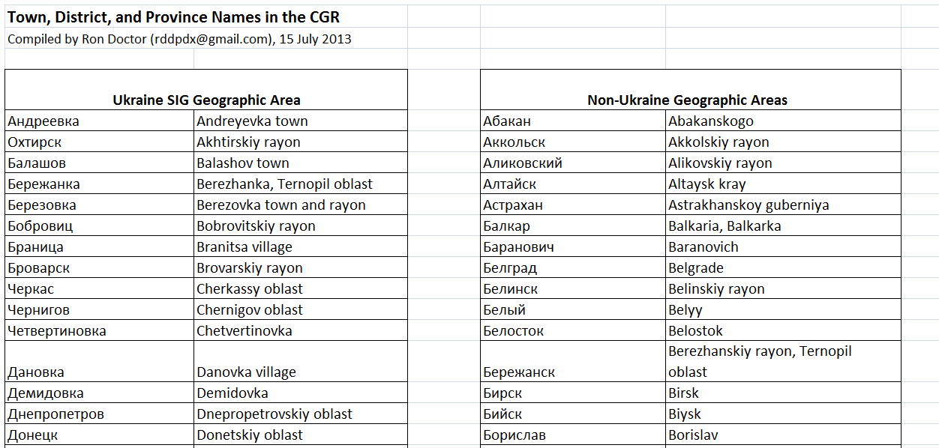
Russian Language Websites
Creating the CGR Dataset
7 August 2013

Slide 20
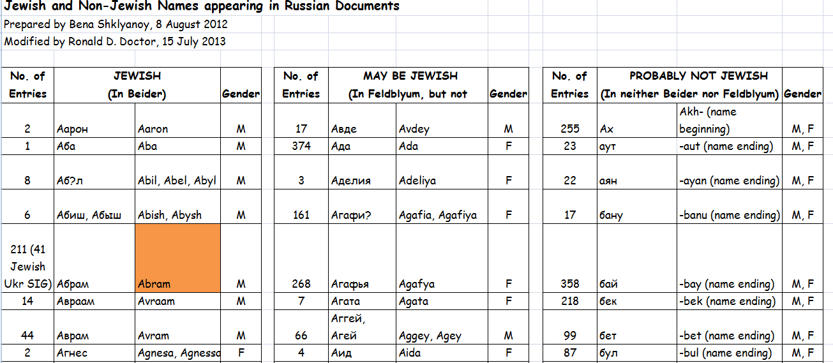
Russian Language Websites
Creating the CGR Dataset
7 August 2013

Slide 21
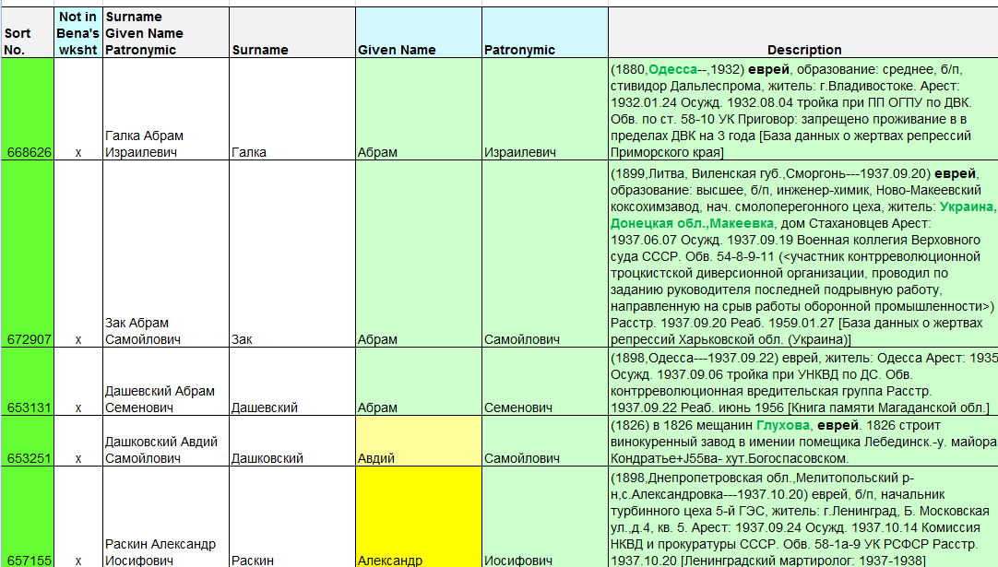
Russian Language Websites
Creating the CGR Dataset
7 August 2013

Slide 22
Other Russian Language Resources
Downloadable book from Google--info. on Jewish Roots:http://www.forum.j-roots.info/viewtopic.php?f=46&t=2902
Downloadable book from Google--info. on Jewish Roots:http://www.forum.j-roots.info/viewtopic.php?f=46&t=2902
http://www.migdal.ru/migdal/events/science-confs/6/17449/,
many names of individuals involved in Jewish higher education are mentioned
http://toldot.ru/urava/cemetery/?show_result=1&country=209&city=%D0%9A%D0%B8%D0%B5%D0%B2&cemetery=9 or
http://tinyurl.com/d4a8zmb The Jewish Cemetery with about 885 alphabetical entries (about 38 pages)
of buried individuals, including names, dates, & photos of headstones.
http://www.forum.j-roots.info/viewtopic.php?f=46&t=2902
Downloadable book from Google--info. on Jewish Roots
http://www.docstoc.com/docs/48682170/Full-name-comments-in-Russian or http://tinyurl.com/b3ztnuy A 1905 voter’s list
http://www.forum.j-roots.info/viewtopic.php?f=71&t=76&start=140 162 books entitled - "Statement of certificates of conviction" for 1870e-1890s years. The books contain lists of prisoners, age, place of birth, to become convicted, punished.
….and many more
7 August 2013

Slide 23
Other Russian Language Resources
Marilyn Robinson identified more than 1,000 data and document sets from Russian language websites. Some of the information dates back to 1810, some date to the early twentieth century and others to the period around World War II.
Volunteers are needed who can read Russian to download, organize and classify these documents.

Slide 24
Cataloging Russian Language Resources
As we explore each document set, we enter information about it into a spreadsheet that Marlis Humphrey developed.. It currently has over 460 entries.
Bena Shklyanoy (benagen@gmail.com), our Translations and Database Director, manages this task.

Slide 25
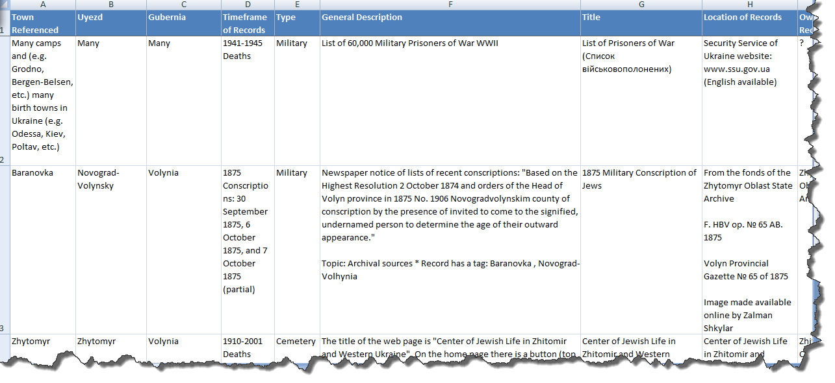
Russian Language Websites
Creating a Catalog

Slide 26
Our Success Depends on You
Will you volunteer?
  No special skills needed for several projects
  Limited language skills needed for some projects
  Some require data input to spreadsheets
Series of Surveys … Languages Survey at:
  http://www.jewishgen.org/ukraine/ABT_Survey_Lang_Form.asp
No skills or time? Help by donating $
http://www.jewishgen.org/JewishGen-erosity/v_projectslist.asp?project_cat=22
7 August 2013

Slide 27
Ukraine SIG Online Survey
Assess volunteer capabilities
Assign volunteers appropriately to projects
Make better use of talents of volunteers
7 August 2013

Slide 28
Ukraine SIG Online Survey
Understanding our Volunteers –
They are at all stages of their personal research
They have different levels of language skills in Cyrillic, Hebrew, Yiddish and Polish
Their spreadsheet knowledge ranges from beginner to expert
Some are ready to get to work now
Some have asked to be contacted later
Most have no experience designing websites
7 August 2013

Slide 29
Continue? … 3 Choices
Discuss Project Details
Tour of the Website
Enough … Let’s Stop
7 August 2013

